Slide 1
Calculation Policy
For Grove Church of England School

Slide 2


Addition Stage 1
Use pictures and objects to count all.
(Combining two groups and counting all)
3 + 2 =
+

Slide 3
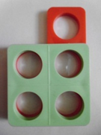
Addition Stage 2
Use number track / fingers / objects / hundred square to count on from any number (Counting on)
‘eight add two more makes ten’
35 36
44 46
54 55 56
‘one more than four is five’
e.g. 45 + 10 without counting on in 1s

Slide 4
Addition Stage 3
Use a number line to count on in ones starting with the largest number.
0 1 2 3 4 5 6 7 8 9 10 11 12
18 + 5 = 23
18 19 20 21 22 23 24

Slide 5
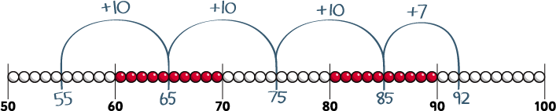
Addition Stage 4
Use a number line to count up tens and then ones, partitioning the smallest number only. e.g. 55 + 37 as 55 + 30 (85) + 7 = 92
Eventually children will be able to draw their own empty number line but to begin with they will use a fully numbered number line.

Slide 6
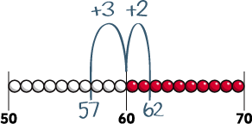
Addition Stage 5
Count up on a number line bridging through 10 e.g. 57 + 5 = 57 + 3 (60) + 2 = 62
4
Children use their knowledge of pairs to 10 to bridge through ten to calculate more efficiently

Slide 7
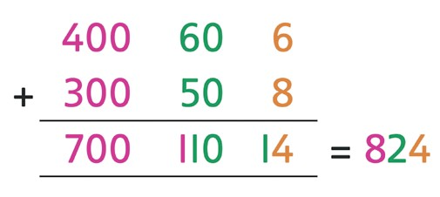
Addition Stage 6
Expanded Horizontal
e.g. 466 + 358
Children need to check their working with a number line.

Slide 8
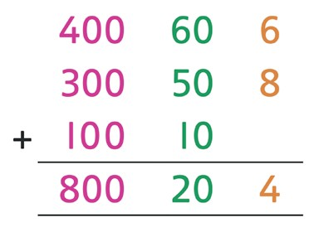
Addition Stage 7
Expanded horizontal
e.g. 466 + 358

Slide 9
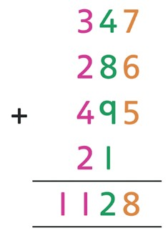
Addition Stage 8
Formal Column Addition - move and use
e.g. 347 + 286 + 495
The concept of regrouping is introduced through continued use of practical equipment. – move and use

Slide 10

Subtraction Stage 1
Take away objects or cross out pictures

Slide 11
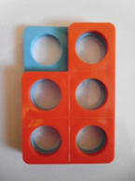

Subtraction Stage 2
Use number track / fingers / objects / hundred square to count back in ones / tens (Counting back)
‘six take away two leaves four’
‘one less than six is five’

Slide 12
Subtraction Stage 3
Use number line to count back in ones
13 – 5 = 8
Encourage children to become more efficient

Slide 13


Subtraction Stage 4
Use a number line to count on to find a small difference
Support with concrete manipulatives

Slide 14
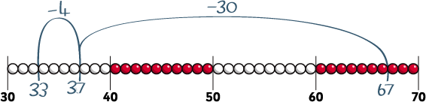
Subtraction Stage 5
Use number line to count back in tens and then ones.
Partition the second number only
e.g. 67 – 34 as 67 subtract 30 (37) then count back 4 (33)

Slide 15
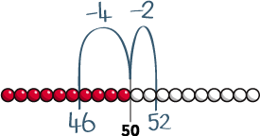
Subtraction Stage 6
Subtraction on a number line more efficiently by bridging through 10
e.g. 52 – 6 as 52 – 2 (50) – 4 = 46

Slide 16
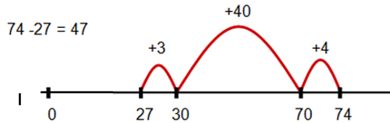

Subtraction Stage 7
Recognise inverse – count up from smaller number to larger number using a number line

Slide 17
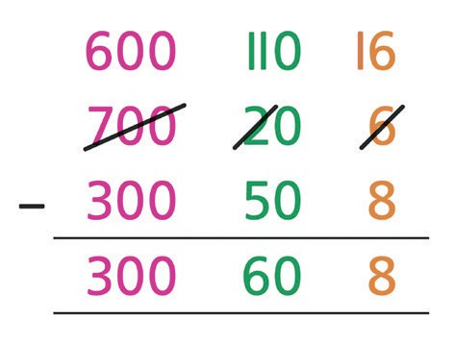
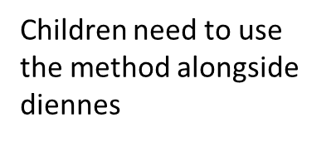
Subtraction Stage 8
Expanded decomposition
e.g. 726 – 358

Slide 18
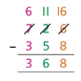
Subtraction Stage 9
Begin to develop compact column subtraction e.g. 726 – 358
Children need to use the method alongside diennes
When secure move on to using decimal numbers

Slide 19




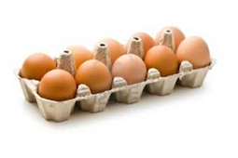
Multiplication Stage 1
Develop conceptual understanding of multiplication
“Lots of”
“double”
“There are 3 sweets in one bag.
How many are in 6 bags?”

Slide 20


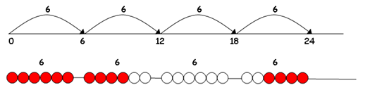
Multiplication Stage 2
Understand multiplication as repeated addition.
5 X 3 3 X 5
Arrays and number lines need to be used alongside one another
6 X 4 = 24

Slide 21
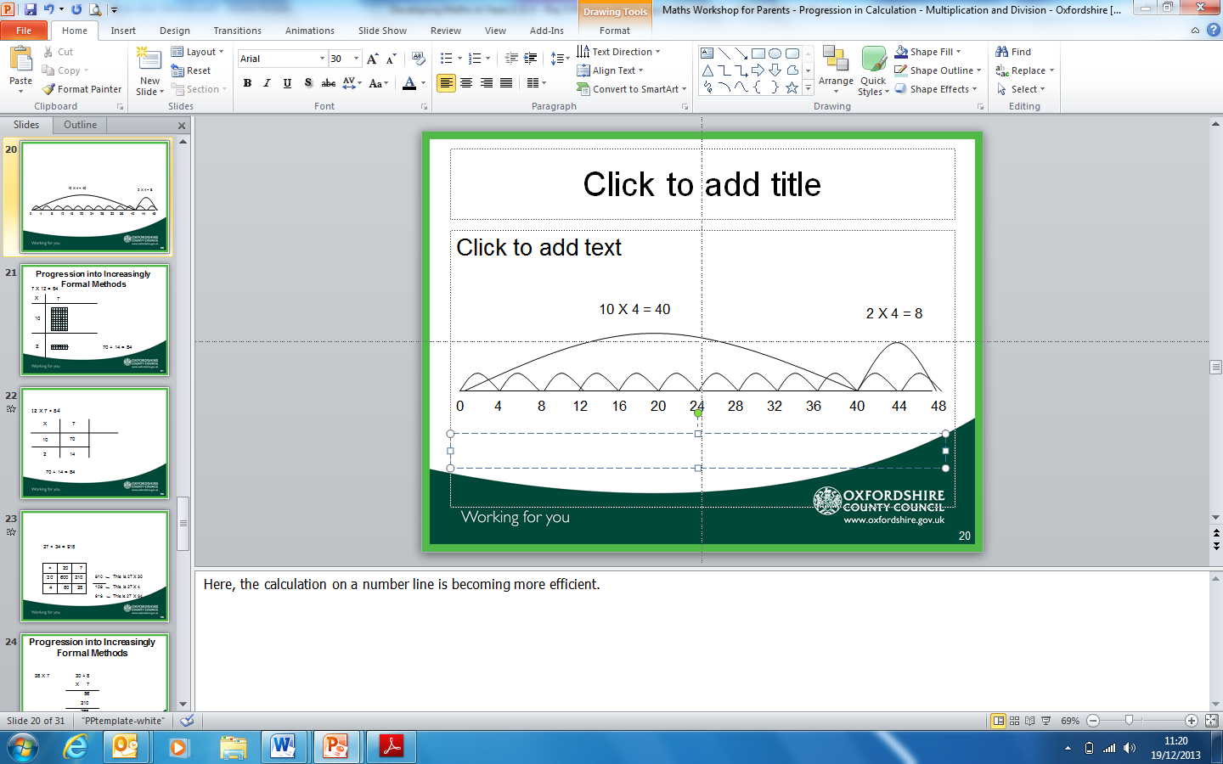
Multiplication Stage 3
Relate multiplying a 2-digit by 1-digit number using repeated addition and arrays to represent:
3 x 13 = 39
4 X 12 = 48
X | 10 | 3
3
4 X 10 = 40 4 X 2 = 8

Slide 22
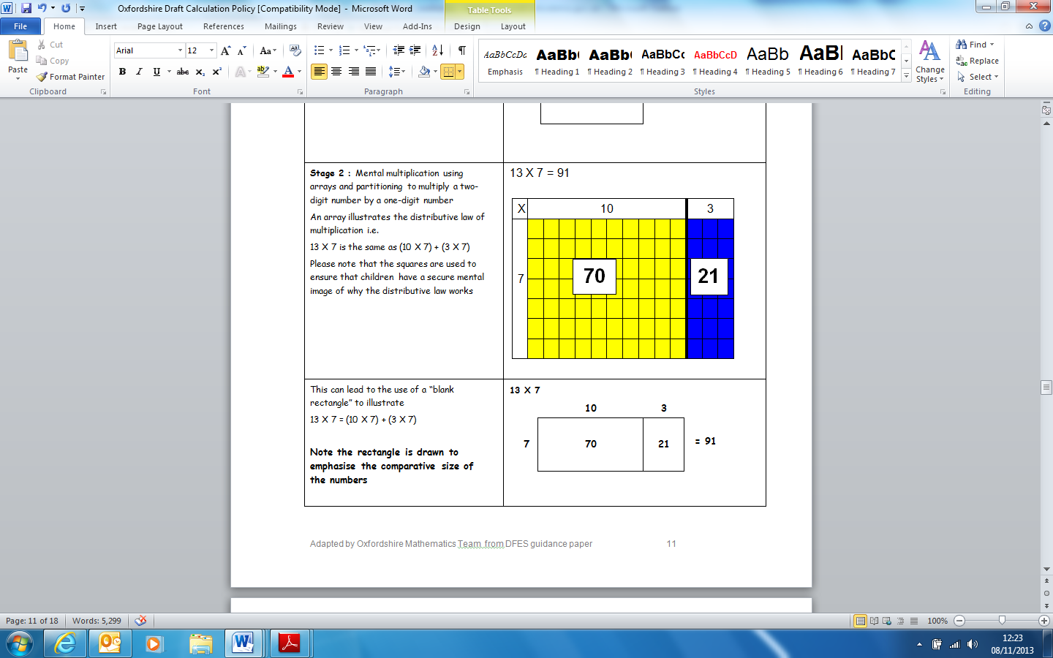
Multiplication Stage 4
Relate multiplying a 3/2-digit by 1-digit number with arrays
7 X 13 = 91
7 X 10 = 70
7 X 3 = 21
_____ = 91

Slide 23
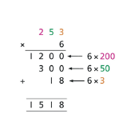
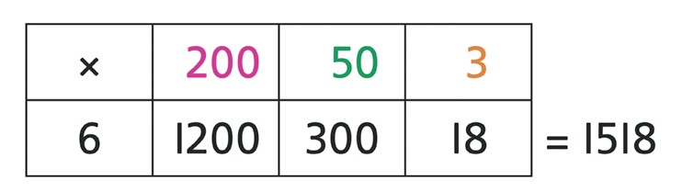
Multiplication Stage 5

Slide 24
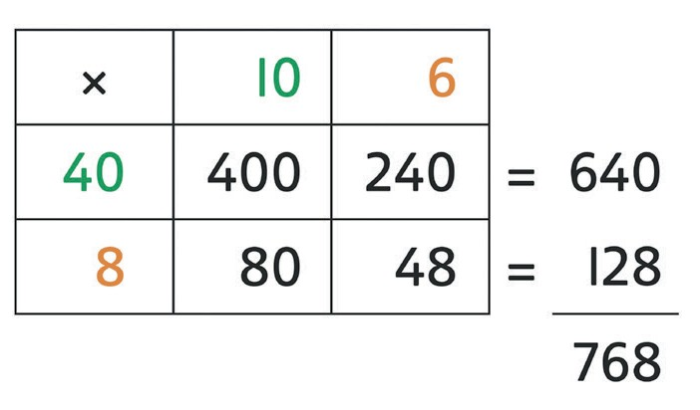
Multiplication Stage 6

Slide 25
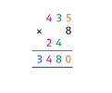
Multiplication Stage 7
Short multiplication of 2-, 3- and 4-digit numbers by 1-digit numbers
e.g. 435 × 8

Slide 26
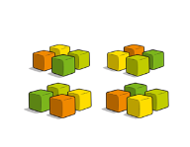
Division Stage 1
Share objects into equal groups

Slide 27
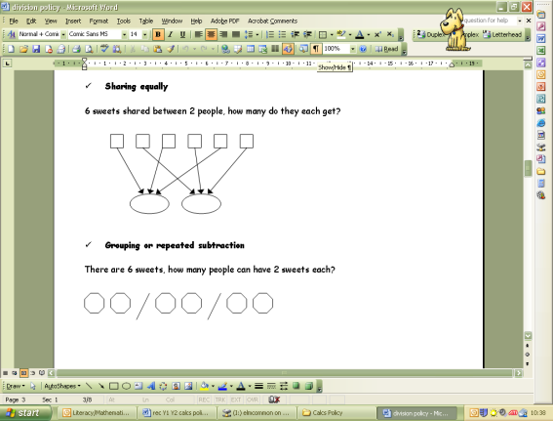
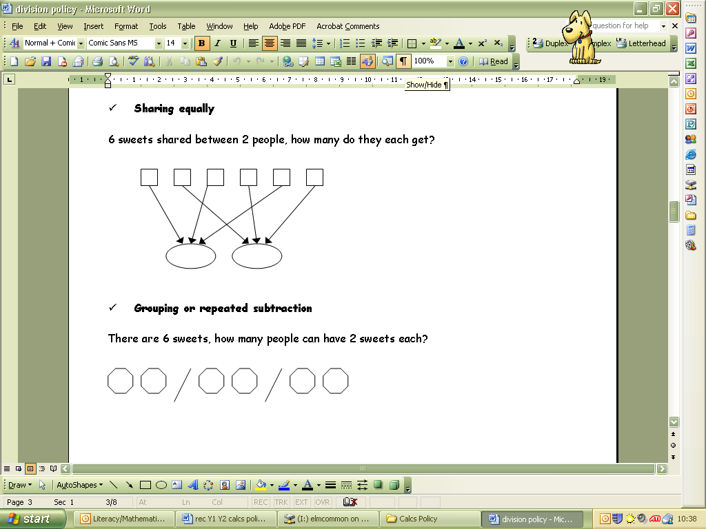
Division Stage 2
Use objects, pictorial representations and arrays to show the concept of division as grouping and sharing.
“12 children get into groups of 4 to play a game”

Slide 28

Division Stage 3
Put dots in circles for sharing
24 ÷ 6 =
Make links with multiplication and arrays.
3 x 5 = 15 so 15 ÷5 = 3

Slide 29
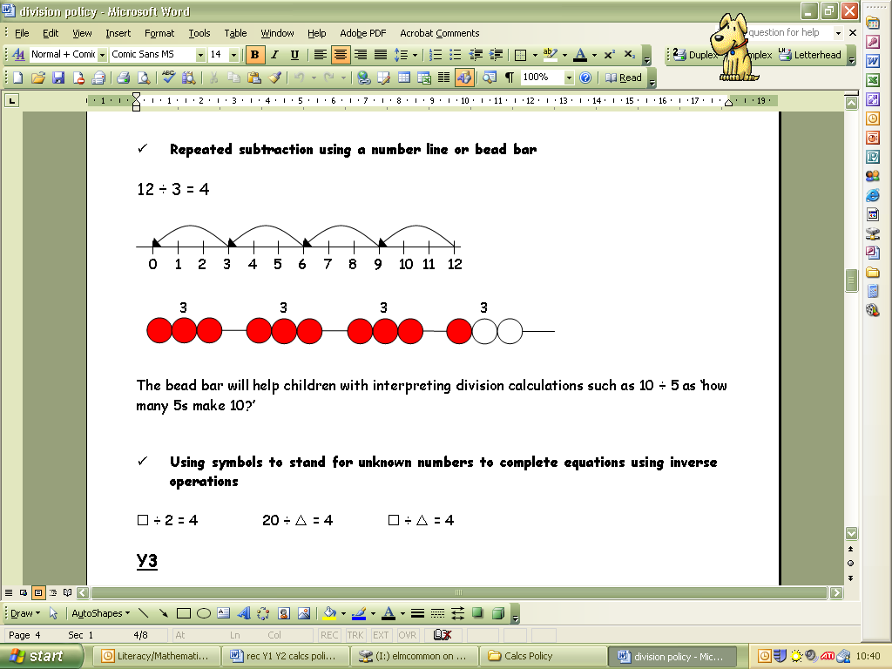
Division Stage 4
Introduce repeated subtraction using a number line (equal steps)
12 ÷ 3 = 4
Link the number line to the dots placed in the circles. “If I give them 1 each I have to subtract a chunk of 3.”
Eventually using these methods for division with remainders

Slide 30
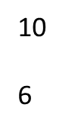
Division Stage 5
Calculate more efficiently – make bigger jumps on the number line
X 6 = 96
10
6
10
6
10
6
Children may begin to count up on a number line rather than back.

Slide 31
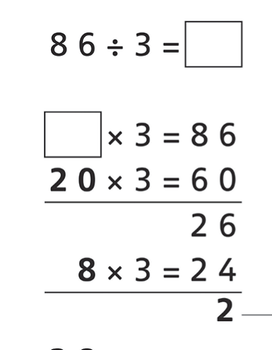

Division Stage 6
Chunking – relate the bigger jumps on the number line to chunking method drawing on inverse
e.g. 86 ÷ 3 as 20 × 3 (60)
and 8 × 3 (24),
remainder 2
Eventually children will use chunking without using the number line.
r

Slide 32

Division Stage 7
Short division
e.g. 139 ÷ 3
This method will only be taught to children at teacher’s discretion.

